Slide 1

Power 5 vs. Non-Power 5 (Kicking Edition)
Jeremy Song, Alec Zhang

Slide 2

Our Investigation/Goal
The goal of our project is to evaluate whether attending a Power 5 school influences early NFL success. We focus specifically on kickers, using college performance metrics to explain NFL outcomes during each player's first three seasons. Based on initial findings, we later expanded our analysis to include wide receivers for comparison across positions.

Slide 3
Kicking Data
We analyzed data for NFL kickers who started in 4+ games during the 2023–2024 season. For each kicker, we collected:
College Variables (used as predictors):
FG%: Field goal percentage in college
XP%: Extra point percentage in college
FGM: Total field goals made in college
Pts: Total points scored in college
G: Games played in college
P5: Whether the kicker attended a Power 5 school (1 = yes, 0 = no)
NFL Variables (used as outcomes):
All NFL stats reflect each player’s first 3 seasons in the league:
ScoringFG%: Average NFL field goal percentage
ScoringFGM: Total NFL field goals made
ScoringXP%: Average extra point percentage
FPTS / FPTS/G: Total and average fantasy points Award: Binary indicator for any NFL award
FG Attempts by Distance:
0–19 FGA, 20–29 FGA, 30–39 FGA, 40–49 FGA, 50+ FGA: Total attempts by distance range
FGM by Distance: Corresponding field goals made in each range

Slide 4
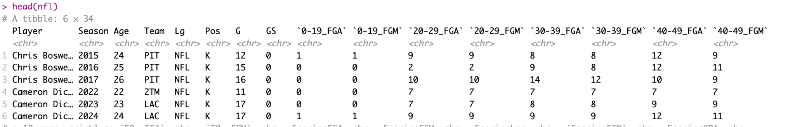
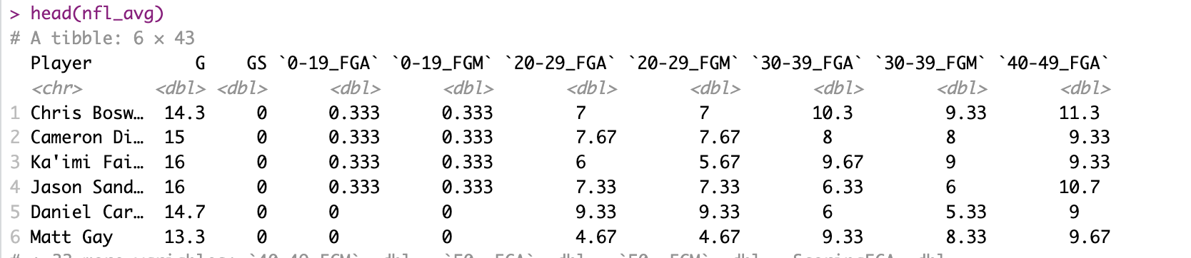
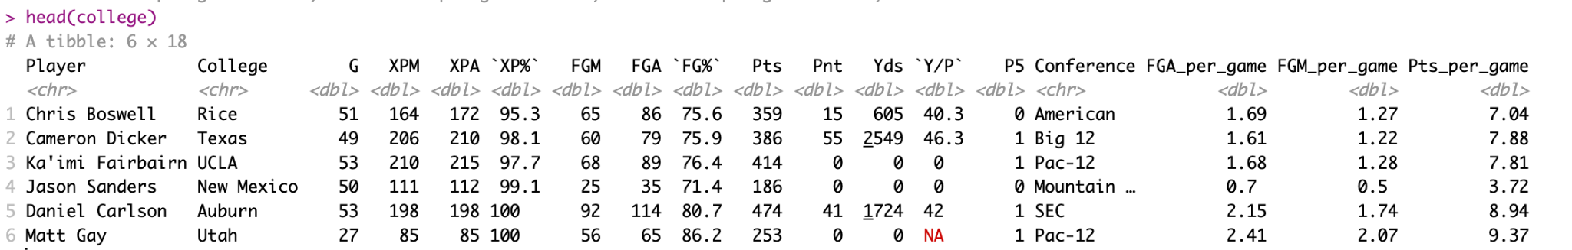
First Few Rows of Dataset used in Analysis

Slide 5
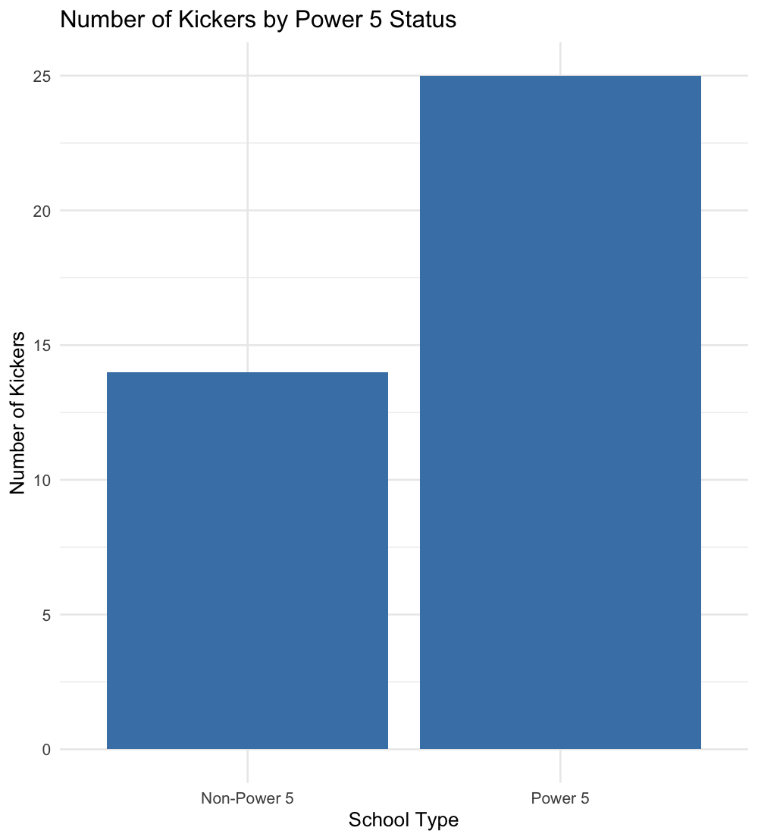
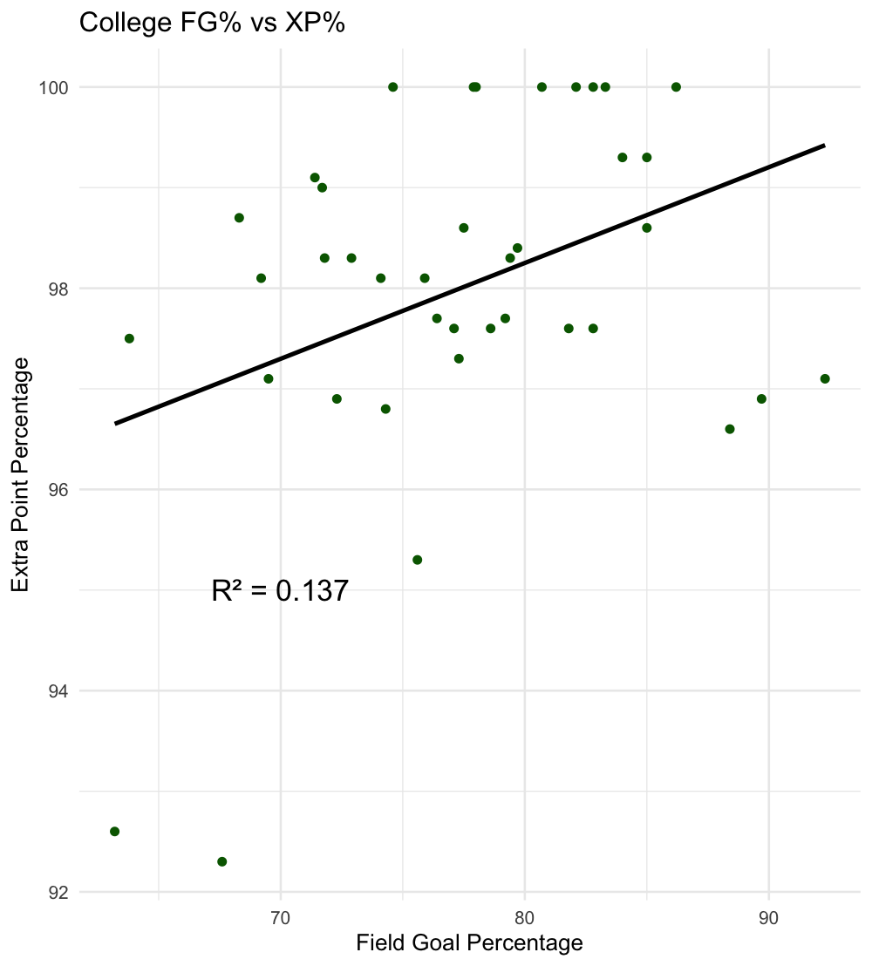
EDA Plots
Notes:
maybe add a plot for receivers

Slide 6
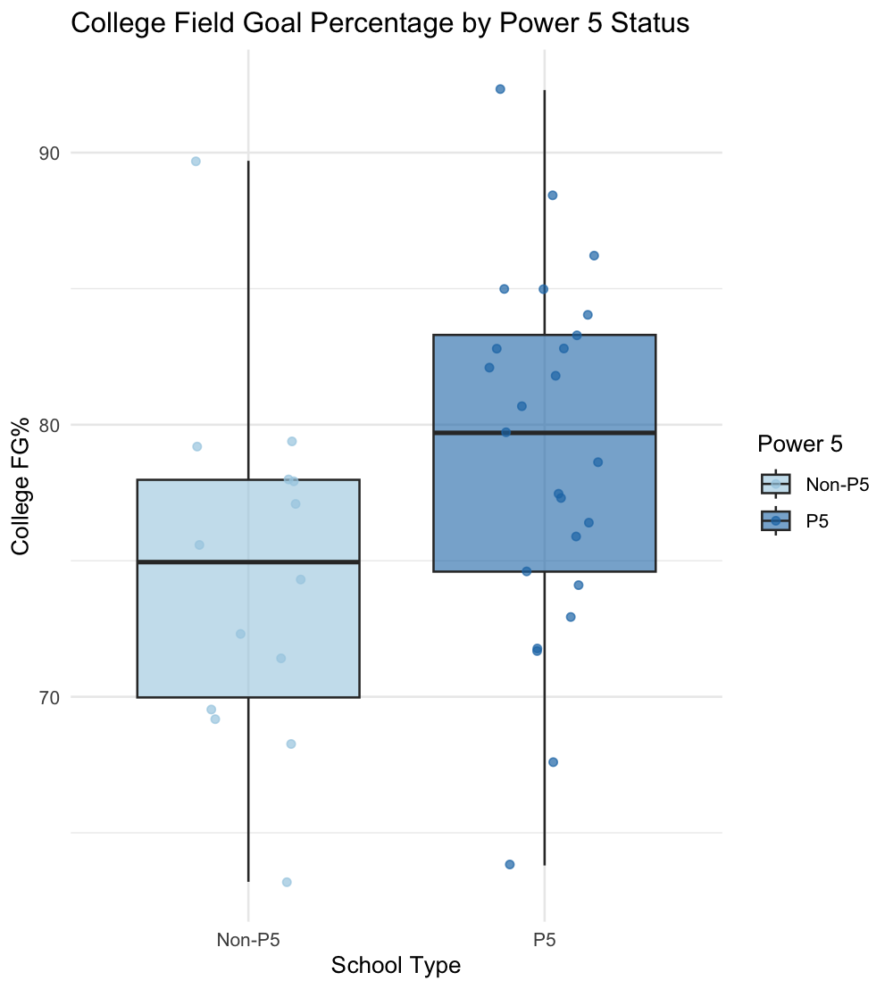
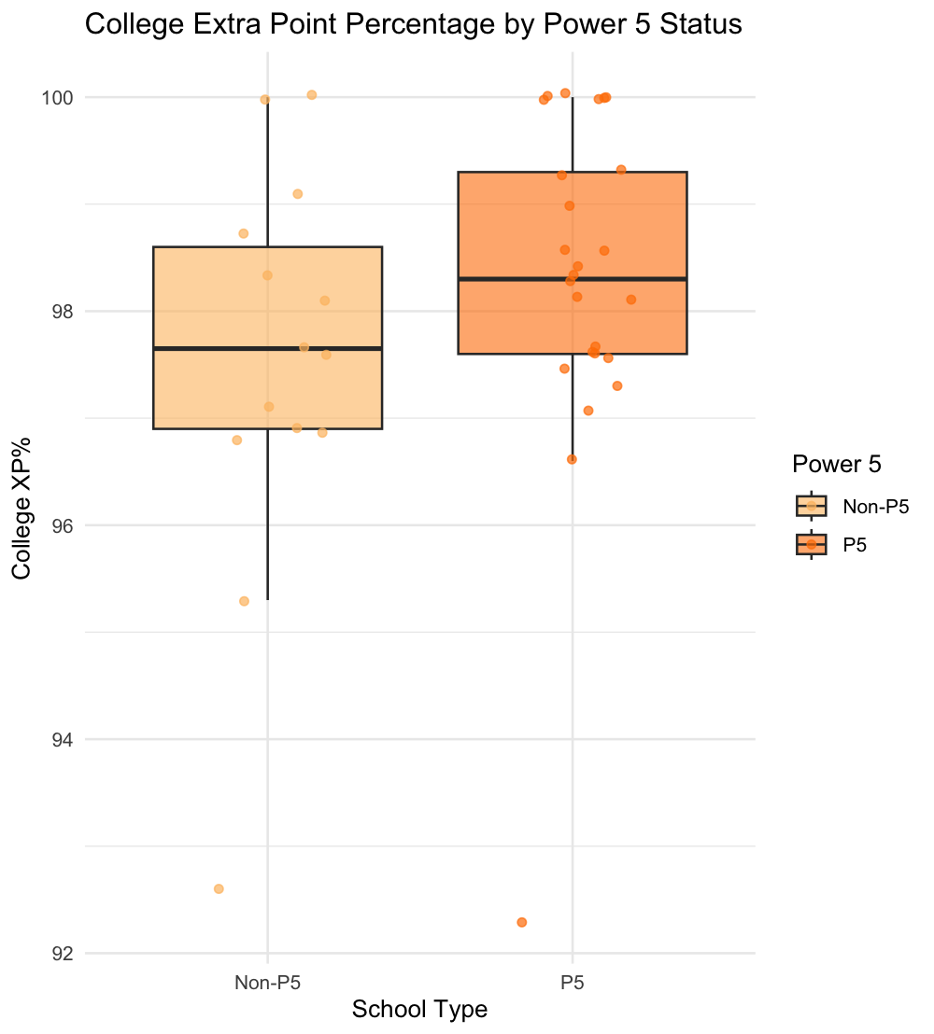
EDA Plots

Slide 7
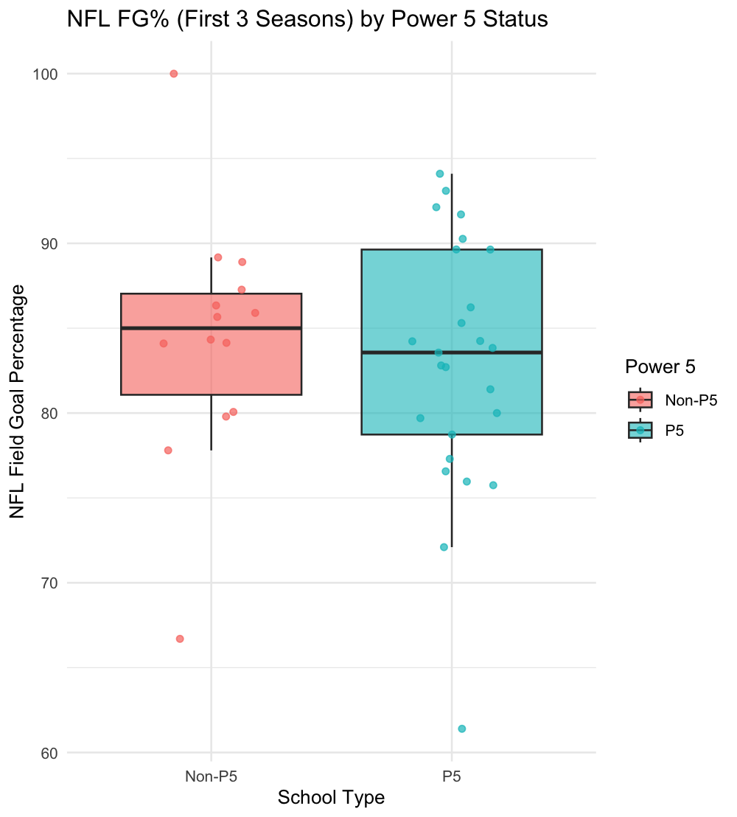
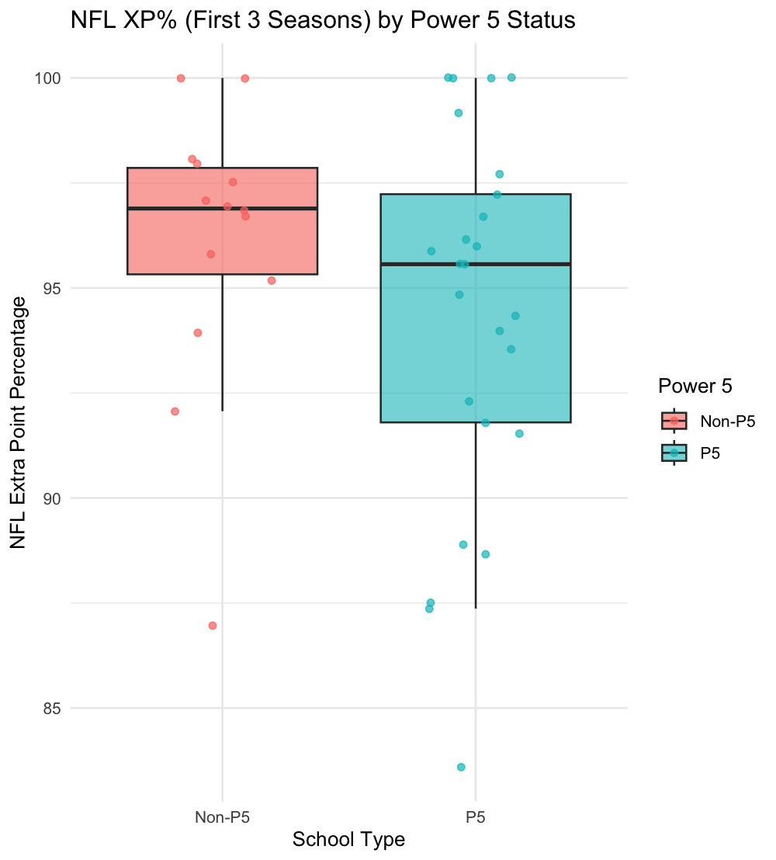
EDA Plots

Slide 8
Overview of Analysis
NFL Performance Metric = β0​ + β1​⋅Power5 + β2​⋅College FG% + β3​⋅XP% + β4​⋅(FGM/Games) + β5​⋅(Pts/Games) + β6​⋅Games
Where:
Power5 is a binary variable (1 = Power 5, 0 = non–Power 5) FG%, XP%, FGM/Games, Pts/Games, Games are continuous variables from college

Slide 9
Methodology
Data Collection
College Data: Career stats for each kicker (played 4+ games in the 2024 NFL season), including FG%, XP%, FGM/game, TP/game, and games played. Power 5 status was encoded as a binary variable.
NFL Data: First 3 season stats for each kicker.
NFL Averages: Averaged performance data across each kicker’s first 3 NFL seasons, including FG%, XP%, fantasy points, etc.
Preprocessing
Joined college and NFL data by player name.
Computed per-game versions of certain variables (e.g., FGM/Game, Points/Game) to control for variation in playing time.
We dropped players that did not play in college (etc. Jake Bates)

Slide 10
Methodology Cont.
3. Model Building
Used multiple linear models to assess whether college stats and Power 5 affiliation could explain various measures of NFL performance.
4. Model Evaluation
Examined p-values, coefficients, and R² to assess which predictors (if any) had a statistically significant relationship with NFL performance.
Visualized KNN decision boundaries to explore potential separability between Power 5 and non–Power 5 players based on performance metrics.
5. Comparison
After our results, we expanded the project to include wide receivers.

Slide 11
R Functions Used
lm() – for fitting linear regression models
ggplot() – for data visualization (e.g., scatterplots, boxplots, KNN boundaries)
knn() – To visualize decision boundaries
pivot_longer() – to reshape data when analyzing field goals by distance
read_excel() – to import structured college and NFL data from Excel

Slide 12
Assumptions of our methods
We focused on kickers active in the 2023–2024 NFL season and gathered stats from their first 3 NFL seasons (averages).
We only included current kickers in our dataset.
Why? To compare all players at a similar stage of development.
No interaction terms or higher-order polynomials were used
Keep things more interpretable
We assumed linearity between predictors and the response variable for continuous outcomes, and independence between observations.
Assume each predictor has a straight-line relationship with outcome
Assume each kickers data is independent of others

Slide 13
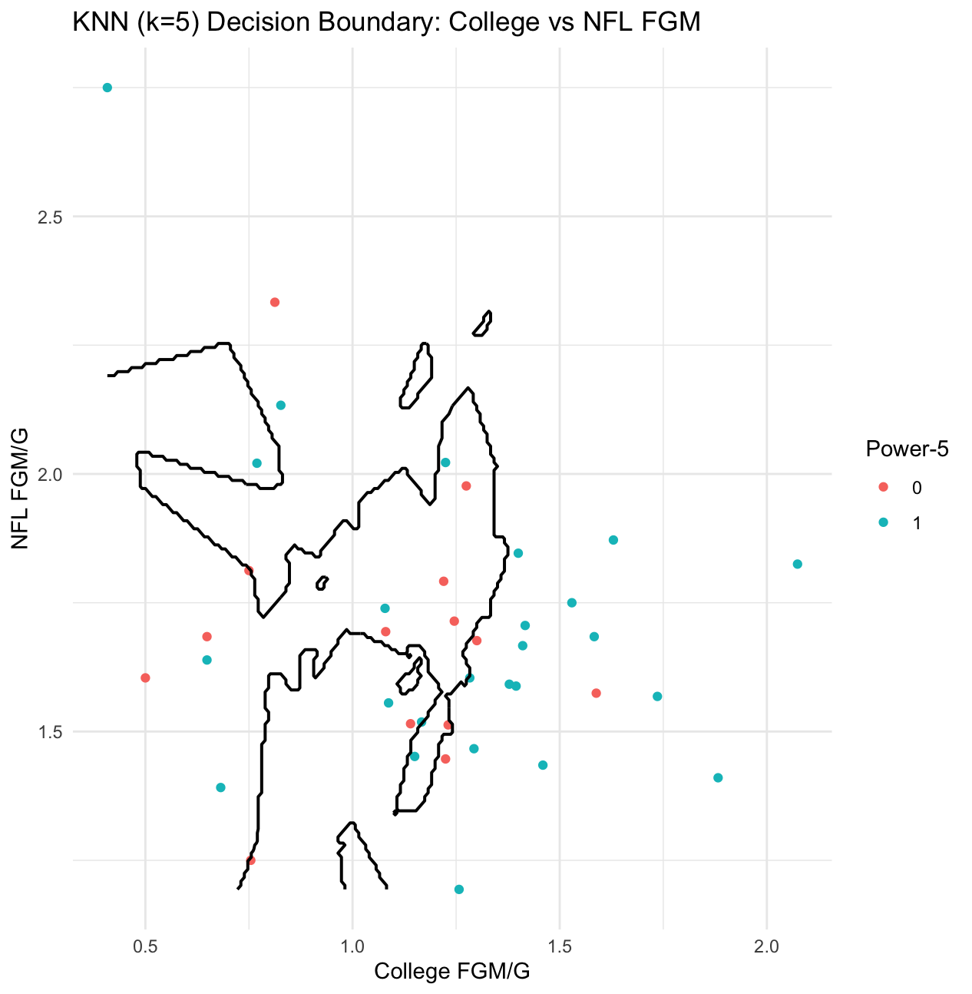
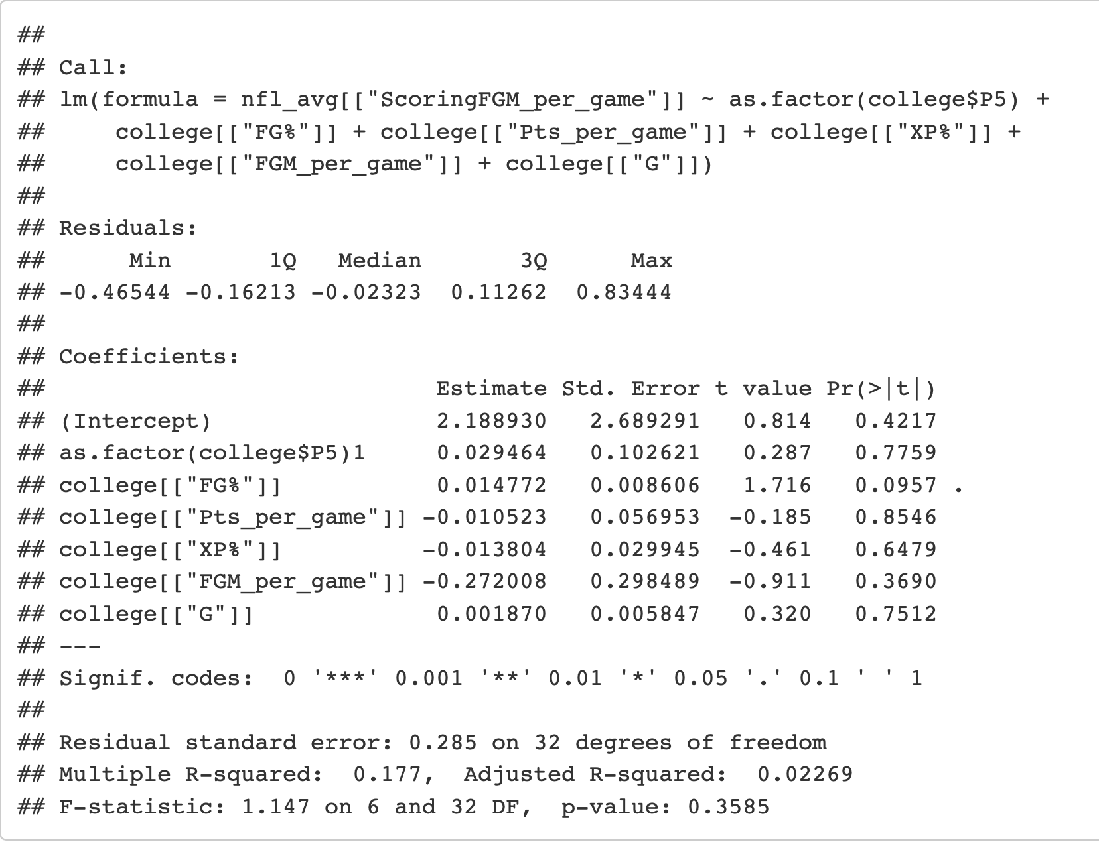
Results - FG/G

Slide 14
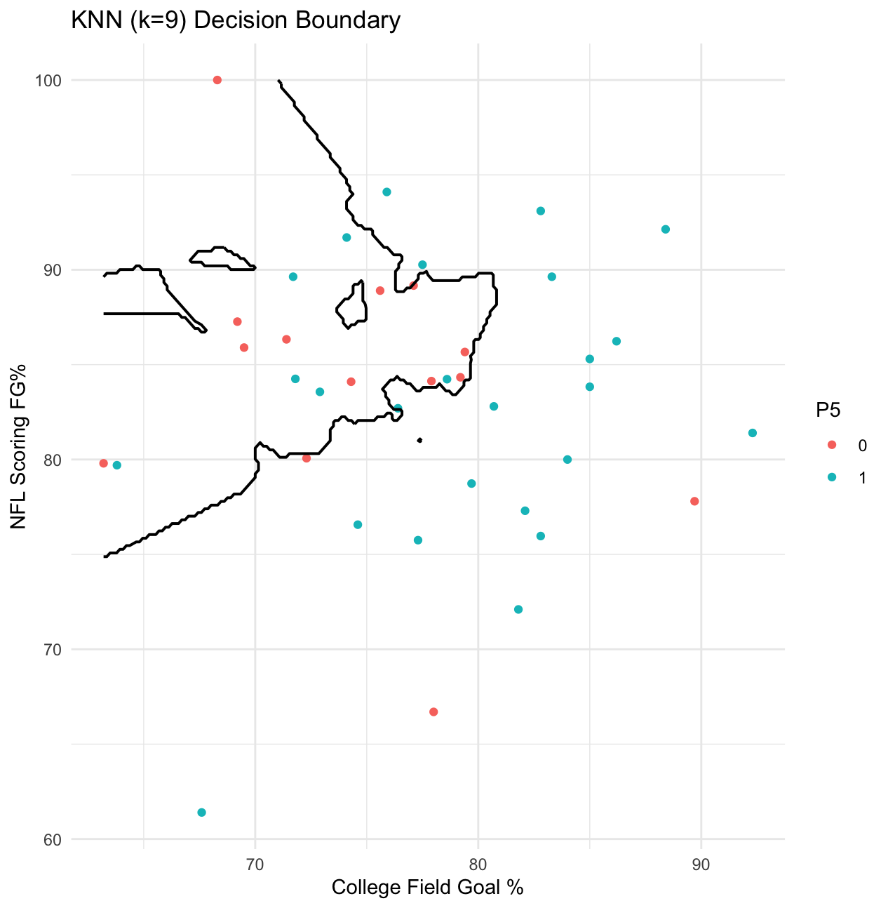
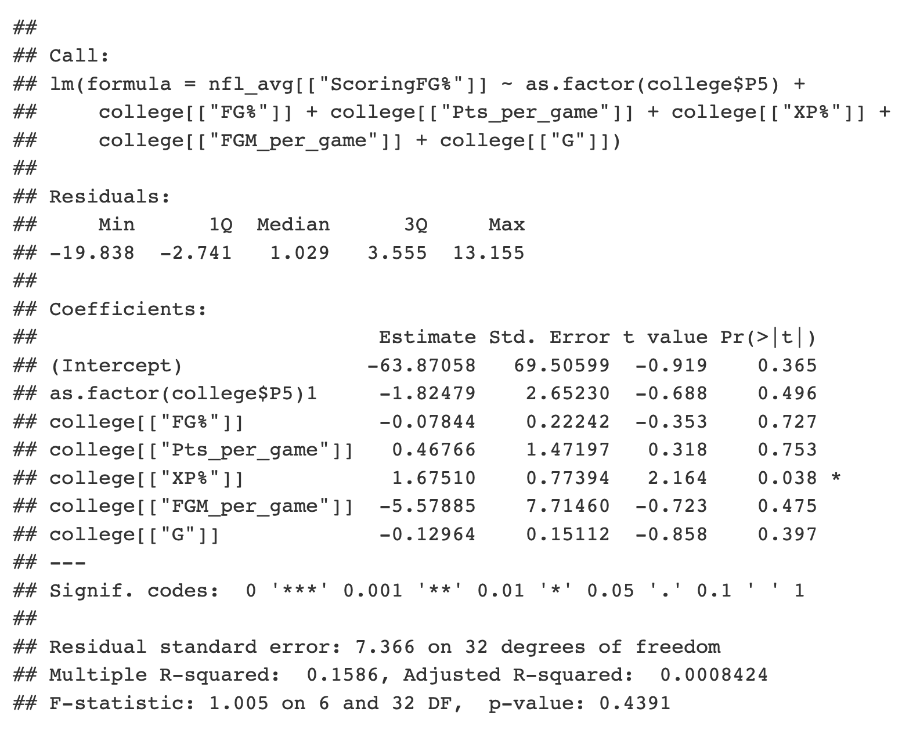
Results - FG%

Slide 15
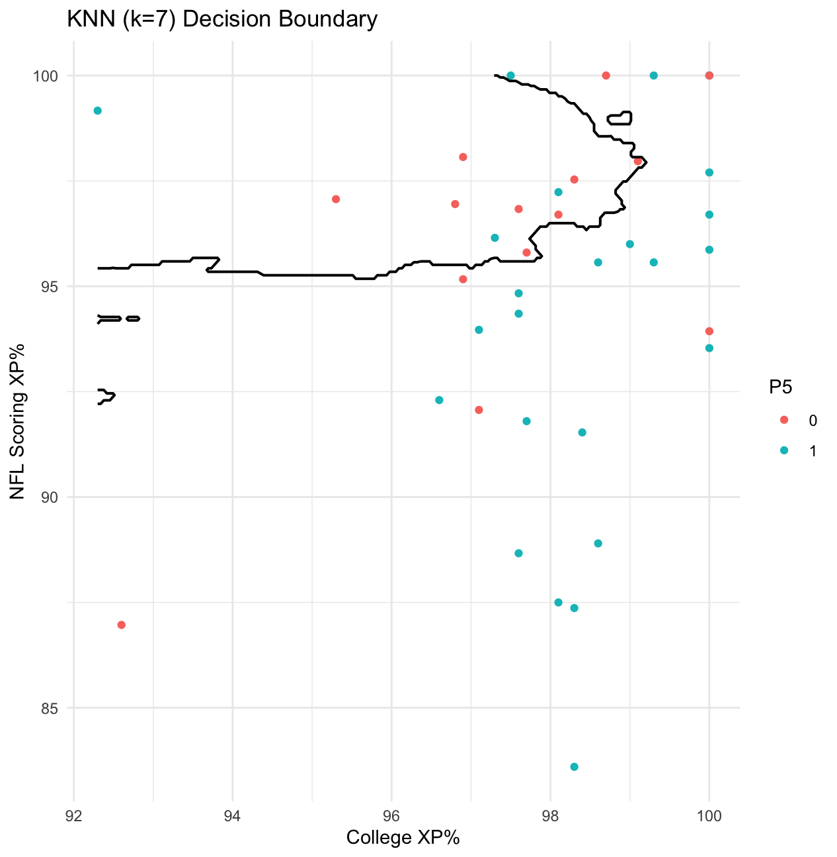
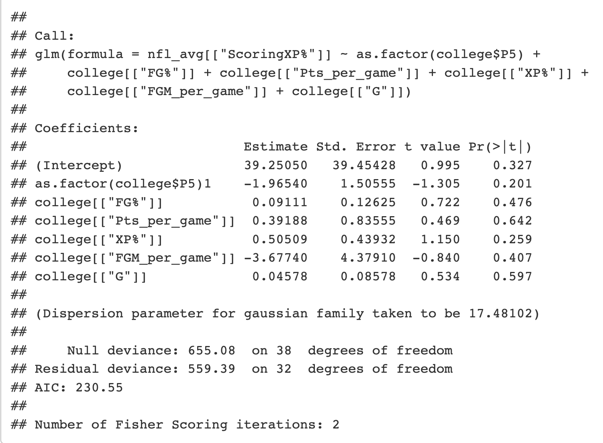
Results - XP%

Slide 16
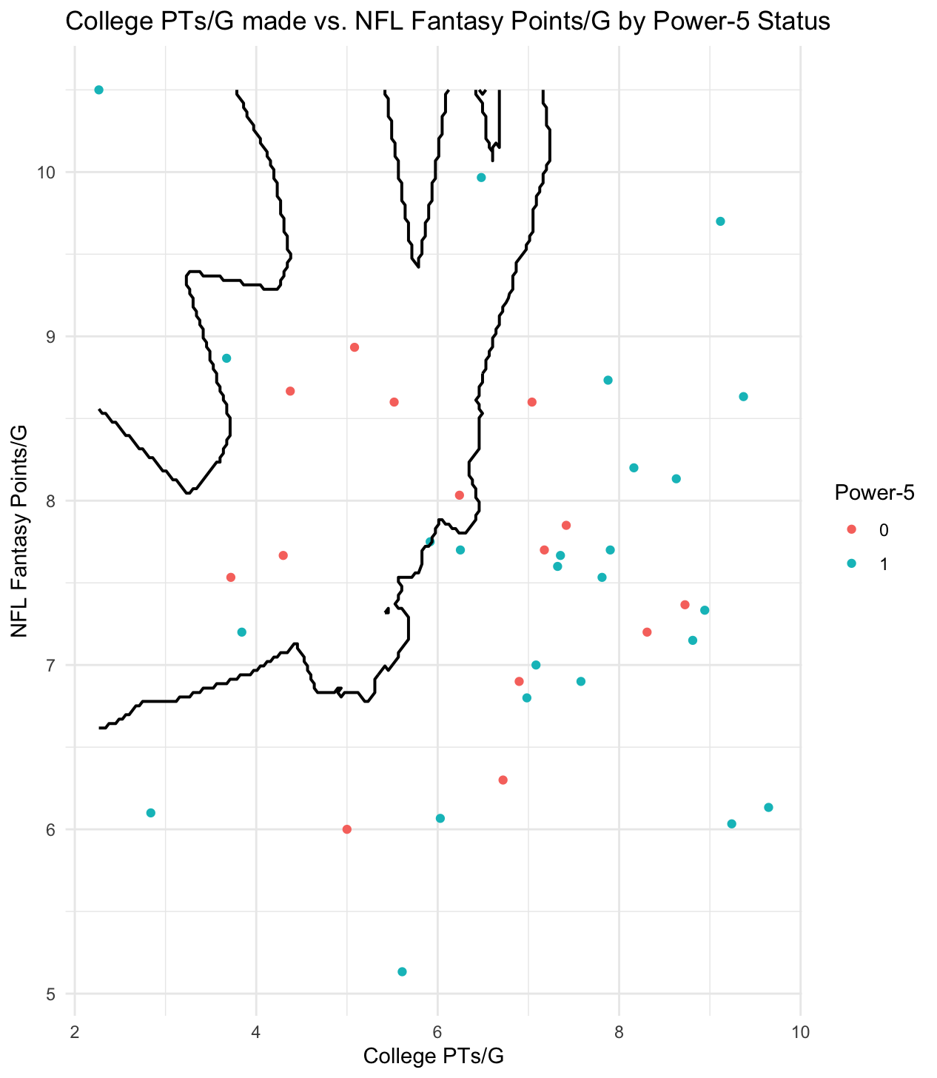
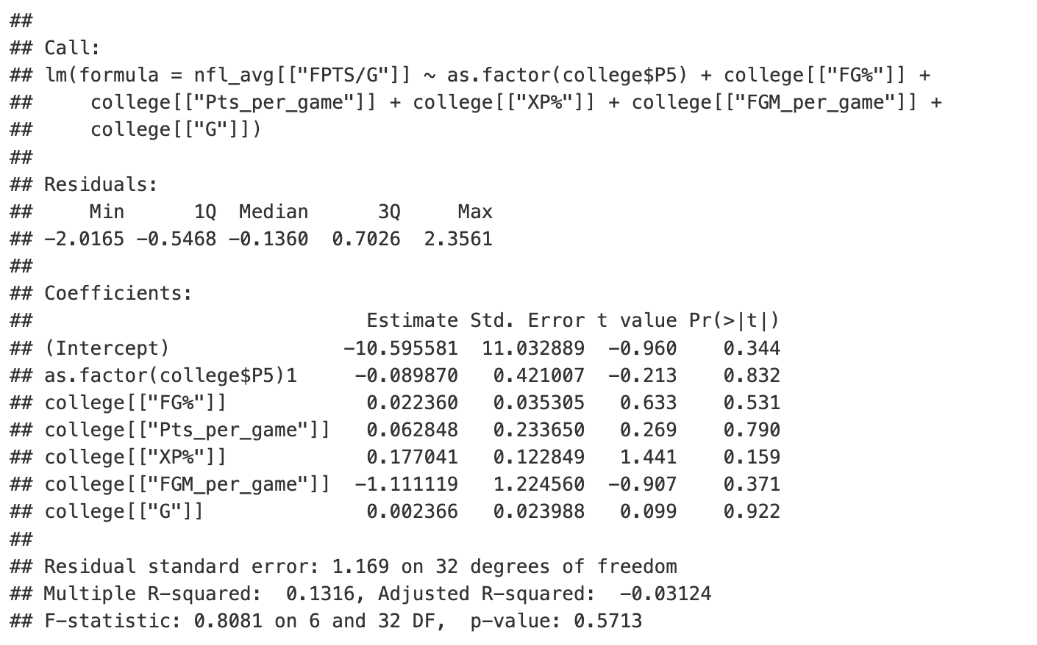
Results - Fantasy Points

Slide 17
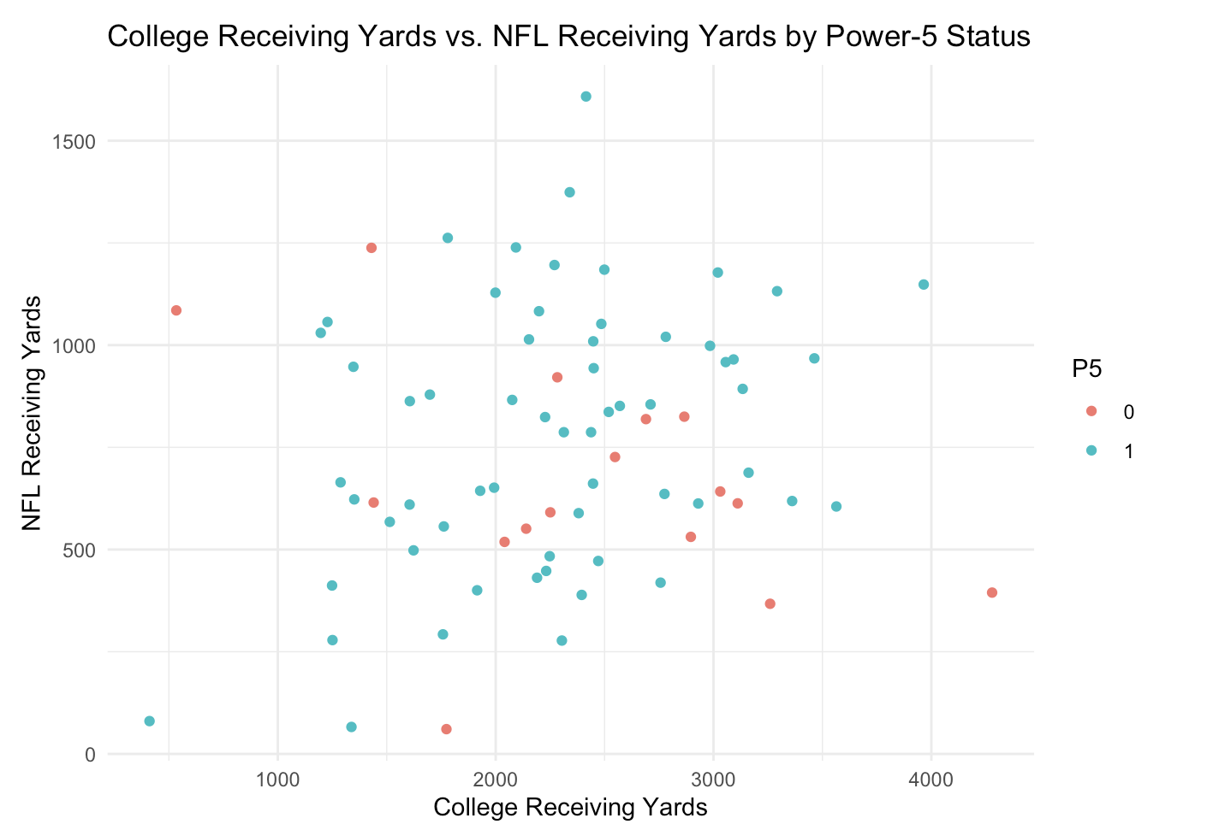
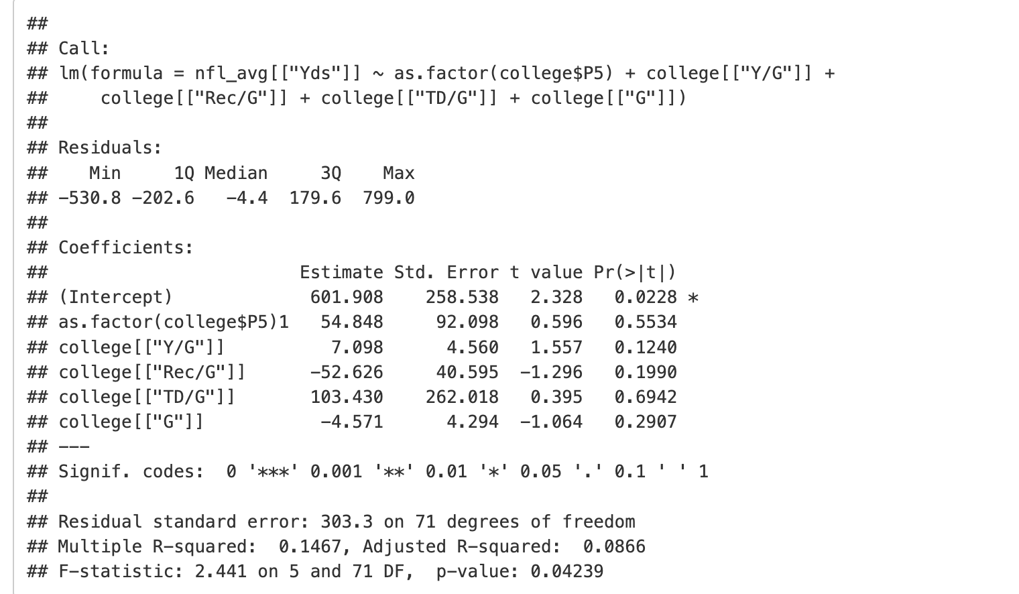
Results - WR Yards

Slide 18
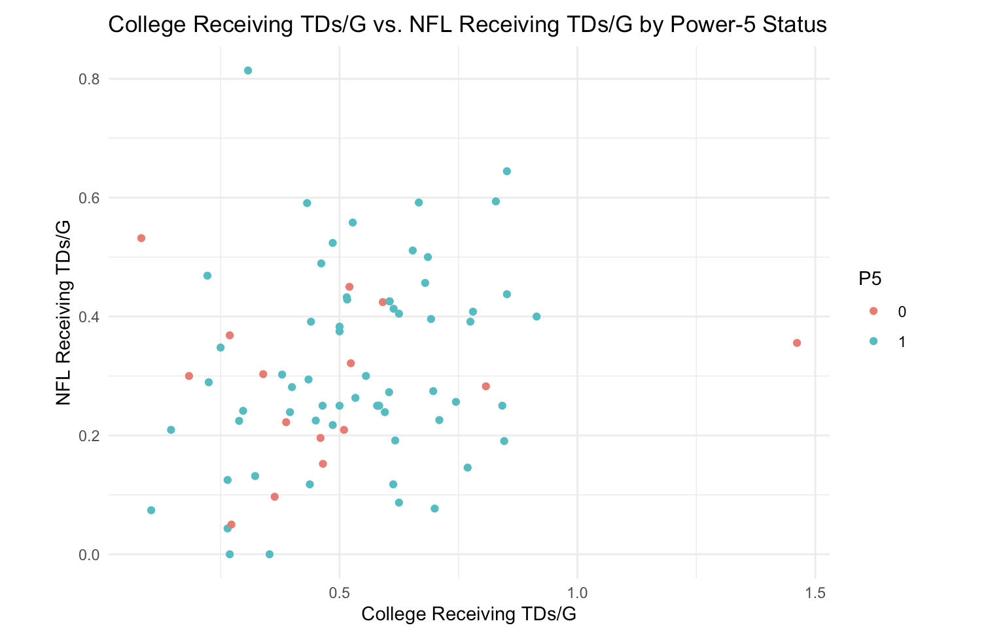
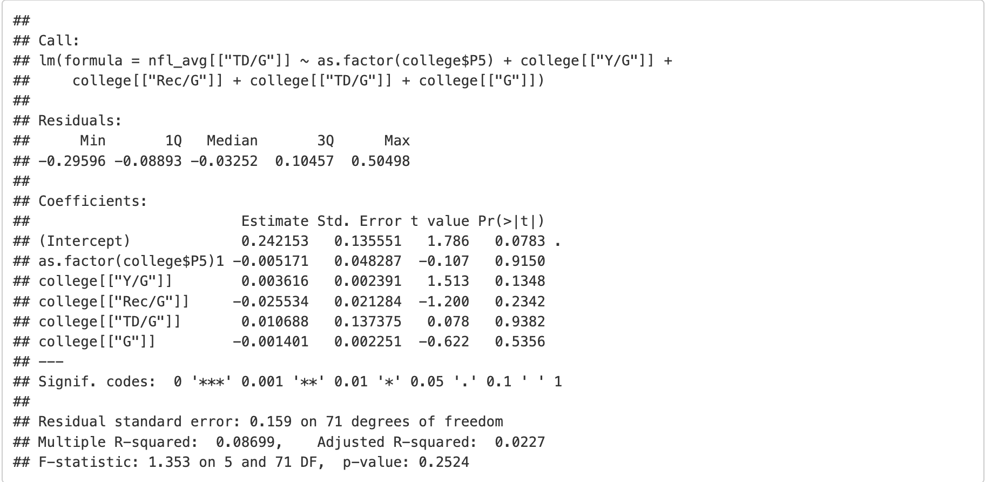
Results - WR TDs

Slide 19
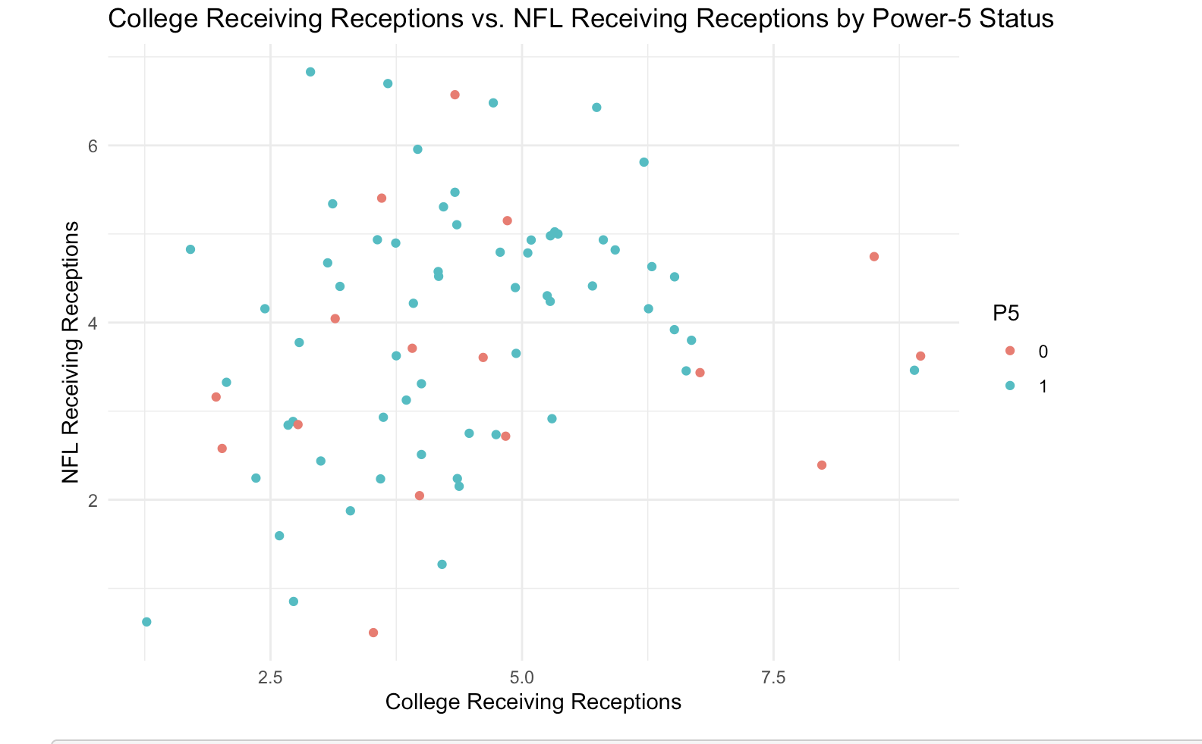
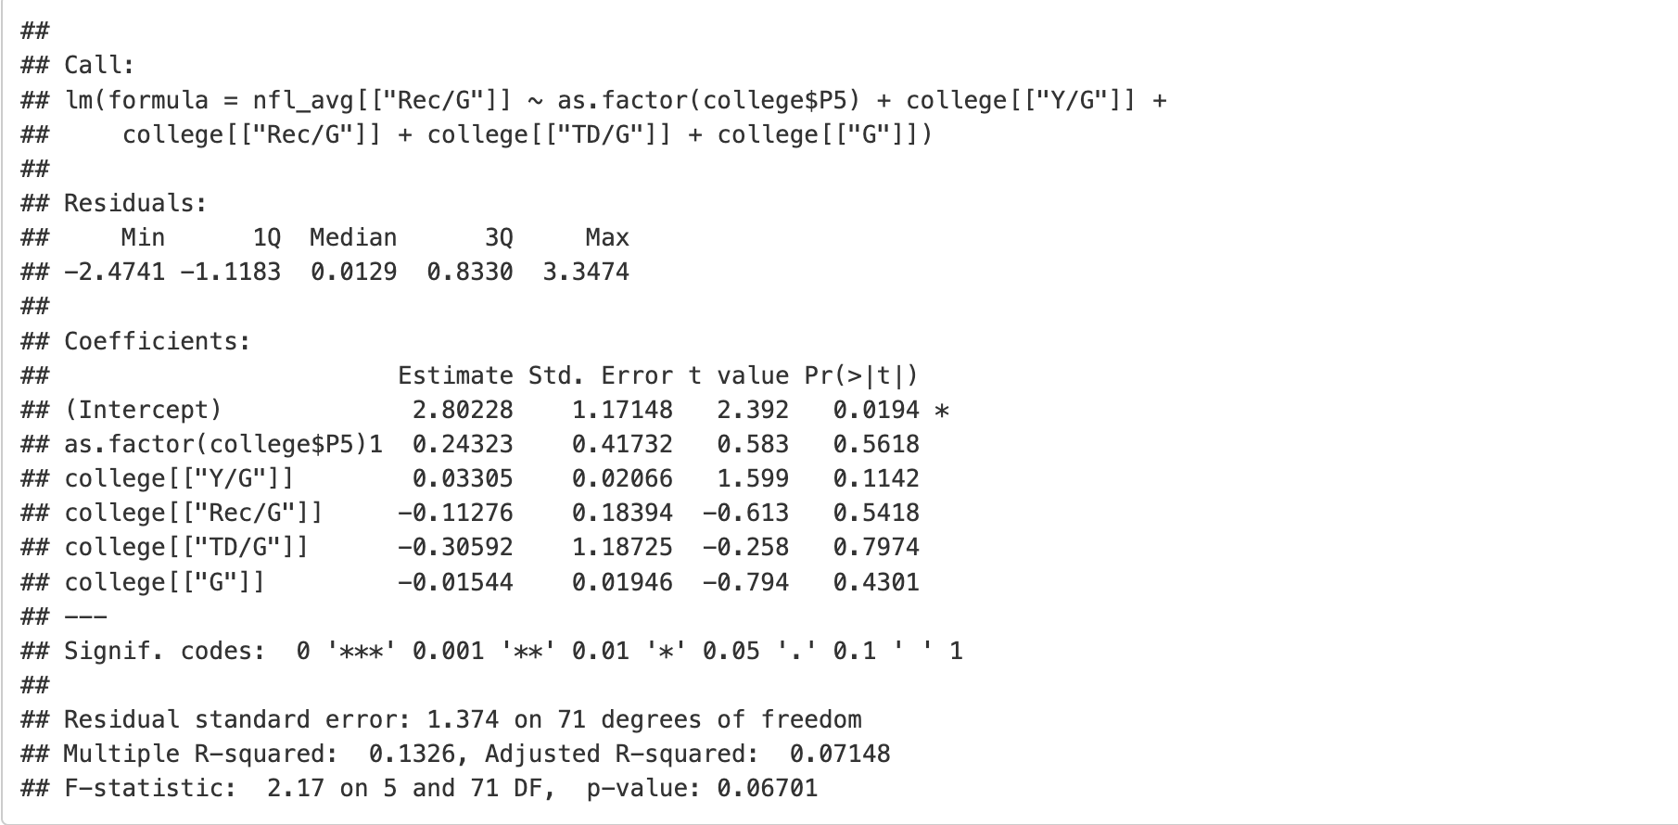
Results - WR Recs

Slide 20
Results - Summary
For Kickers:
Lack of significant differences in P5 vs non-P5 kickers
Lack of strong linearity/predictability in Kicking Statistics
Visually can expect they may not always perform as well in College, however they match their peers in the NFL
For Receivers:
Much more linearity/predictability in receiving statistics
Difference between P5 and non-P5 receivers are even more muddled
Overall: While the performance of kickers seems much more random than other positions in football such as receivers, it becomes apparent that NFL production doesn’t depend on P5 vs non-P5 for any position analyzed. However, we can see that there is a much clearer divide between P5 and non P5 kickers entering into the NFL.

Slide 21
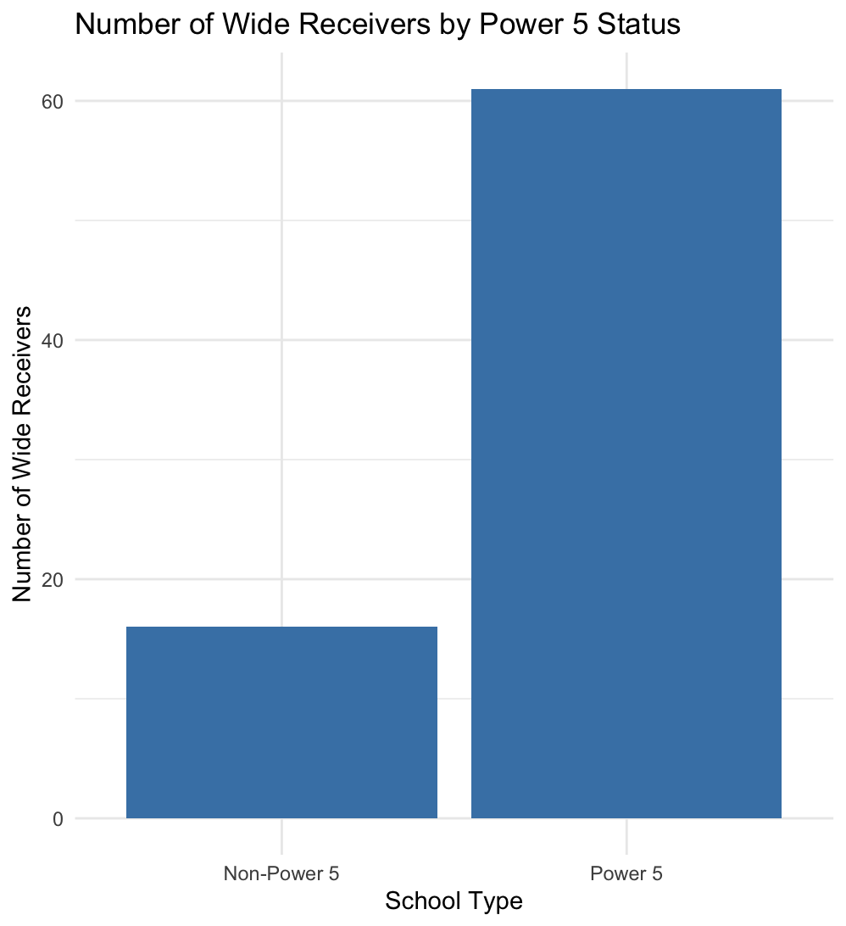
Results - Explanations
Key assumption of linearity between predictors and outcomes is not true in the case for kickers
Did not gather a large enough sample size of receivers or kickers
Inherent selection bias
only those deemed good enough even get a chance in the NFL, muchless stay for more than a few seasons

Slide 22
Suggestions for Further Analysis
Increase sample size by including more kickers across additional seasons or adding retired players
Improve statistical power
Explore non-linear or interaction effects
Maybe the benefit of improving FG% from 80% to 85% is not the same as going from 90% to 95%
Diminishing returns
Use more advanced metrics
PFF grades
Notes:
maybe add years between end of college vs start of nfl career MAybe add some VIF analysis

